Slide 1
React Concepts
BY : Anjali Sharma

Slide 2
Coding Practice
Mini Movie Website with Routing : -
Create a simple multi-page movie website using React Router, where users can navigate between different pages: Home, Movies List, and About.
Your Mini Movie Website should include:
Pages (Components):
Home Page : Welcome message with a heading and a small intro.
Movies Page: A hardcoded list of 5 movies (title + year) displayed in a list.
About Page : Some information about the website or the developer (you!).
404 Page : A fun or informative "Page Not Found" message if user visits a wrong route.
Navbar component : - with nav link that help user to go in different pages
Currently you can try havng static data of movie

Slide 3
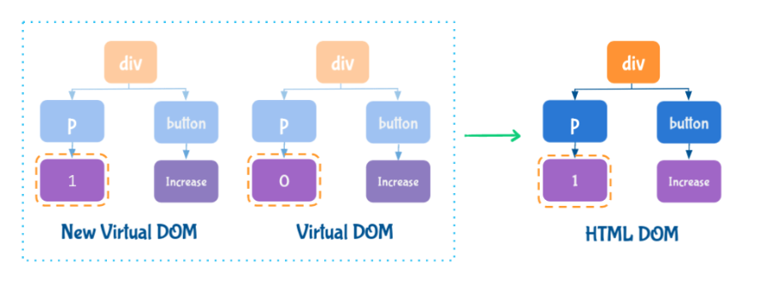
Reconciliation
Virtual DOM :-
A Virtual DOM is a JS object, which is the virtual representation of an HTML DOM. Whenever new elements are added to the UI, a virtual DOM is created.
React compares new virtual DOM with current virtual DOM, and the difference will be efficiently updated to HTML DOM. So, the Virtual DOM helps to render the UI more performantly.
React only updates what's necessary. This process is known as Reconciliation.

Slide 4
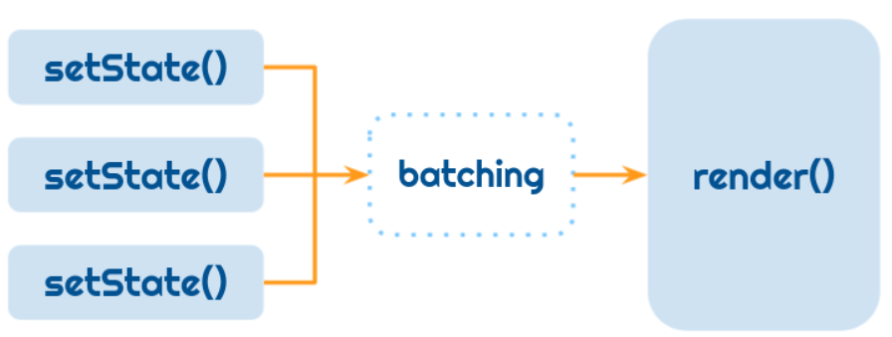
React Batch Updating
React combines multiple setState() calls into single update.
Example :-
onIncrement = () => {
this.setState((prevState) => ({ count: prevState.count + 1 }))
this.setState((prevState) => ({ count: prevState.count + 1 }))
this.setState((prevState) => ({ count: prevState.count + 1 }))
}
In the above example, the render will called only once as React combines multiple setState() calls into a single update.

Slide 5
Children Prop
The children is a special prop that is automatically passed to every React Component.
The JSX Element/Text included in between the opening and closing tags are considered children.
Passing Text as Children :-
import SocialButton from "./SocialButton“
const Post = () => (
<div className="post-container">
<p className="paragraph“>React is fun </p> <SocialButton>Like</SocialButton>
</div>
)
export default Post
Accessing Children :-
const SocialButton = (props) => (
<button className="social-button">{props.children}</button>
)
export default SocialButton

Slide 6
Props vs State
The props and state are plain JS objects.
The props and state changes trigger the render method.
Props | State
Props get passed to the component, similar to function parameters | State is created and managed within the component, similar to a local variables
Props are used to pass data and event handlers down to the child components | State is used to store the component's data that changes over time
Props are immutable. A component cannot change the props | State should be immutable
We need the state to make the applications interactive.
To build the application correctly, you first need to think of the minimal set of the state that the application needs.

Slide 7
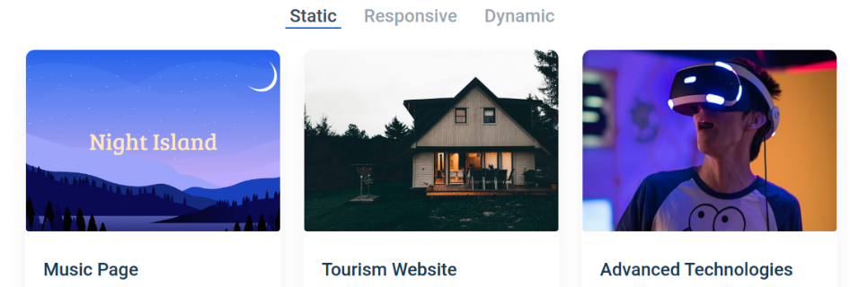
Let's take an example :-
Think of all the pieces of data in the Projects Application. We have:
The original list of projects
The active tab item ( The text decoration of the text – Underline, The color of the text)
The filtered list of projects
Let's go through each one and figure out which one is state. Ask three questions about each piece of data:
Is it passed in from a parent via props? If so, it probably isn't state.
Does it remain unchanged over time? If so, it probably isn't state.
Can it be computed based on any other state or props in the component? If so, it isn't state.

Slide 8
Data | isState | Reason
The original list of projects | NO | It is passed as props
The active tab item | YES | It changes over time and can't be computed from anything
The filtered list of projects | NO | It can be computed by combining the original list of projects with the active tab item
The text decoration of the text - Underline | NO | It can be derived from the active tab item
The The color of the text | NO | It can be derived from the active tab item
So finally, the state is: The active tab item

Slide 9
Third Party Packages
A Third-Party Package is a reusable code developed to perform a specific functionality
Advantages: -
Easy integration
Saves Time
More productivity with fewer lines of code
Better Error Handling
More Customisation Options ... many more.
Node Package Manager contains Third-Party Packages for React JS, Node JS, Angular JS, and many more libraries and frameworks.
Link :- https://www.npmjs.com/
Things to Consider before selecting package
Users Satisfaction
Popularity (number of stars)
Maintenance
Documentation
Number of unresolved issues

Slide 10
SOME IMPORTATN THIRD PARTY PACKAGE :-
react-player :- a third-party package that provides a React component for playing a variety of URLs, including file paths, YouTube, Facebook, etc.
Recharts :- a third-party package to display charts in your application. It supports different types of charts like: Bar Chart , Pie Chart , Area Chart , Composed Chart, etc.
react-chrono :- a third-party package to display the timeline in your application.
It provides a React component Chrono to build a timeline that displays events chronologically.
EXPLORE MORE BY GOING ON NPM

Slide 11

THANK YOU !!!

